Slide 1


Coffee Quality Analysis
Power BI Project

Slide 2
Objective
CQI's mission is to promote coffee quality through a range of activities that include research, training, and certification programs.
The organization works with coffee growers, processors, roasters, and other stakeholders to improve coffee quality standards, promote sustainability, and support the development of the specialty coffee industry.

Slide 3
About Data
The data includes a range of information on coffee production, processing, and sensory evaluation. It also contains data on coffee genetics, soil types, and other factors that can affect coffee quality.
Sensory evaluations (coffee quality scores)
Aroma: Refers to the scent or fragrance of the coffee.
Flavor: The flavor of coffee is evaluated based on the taste, including any sweetness, bitterness, acidity, and other flavor notes.
Aftertaste: Refers to the lingering taste that remains in the mouth after swallowing the coffee.
Acidity: Acidity in coffee refers to the brightness or liveliness of the taste.
Body: The body of coffee refers to the thickness or viscosity of the coffee in the mouth.
Balance: Balance refers to how well the different flavor components of the coffee work together.
Uniformity: Uniformity refers to the consistency of the coffee from cup to cup.
Clean Cup: A clean cup refers to a coffee that is free of any off-flavors or defects, such as sourness, mustiness, or staleness.
Sweetness: It can be described as caramel-like, fruity, or floral, and is a desirable quality in coffee.

Slide 4
Steps involved to analysis Data
Data Exploration
Understand Business Problem and explore the Data Structure
Data Cleaning
Handling Missing values , Dealing with unnecessary columns…
Load the Data in Power Desktop
Exploratory Data Analysis
Visualization

Slide 5
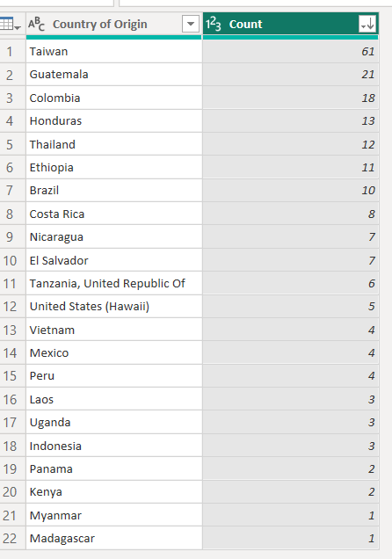
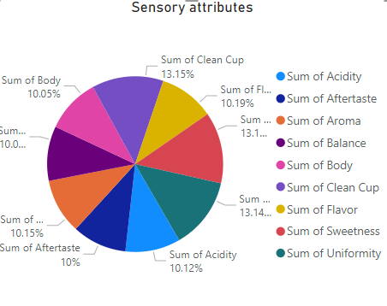
Observation
22 Country involved in CQI
Average Quality Score 83.7 with all the key determinants
Total bag involved in analysis were 47150 and Bag Weight 32177

Slide 6
Insights
Correlation between processing methods, origin regions, impacts the increase in coffee quality scores
Coffee beans from different Regions can improve the quality of cup , with Processing methods enhances the Taste
Highest Coffee Quality with 89% is achieved in Double Anaerobic Washed Processing Method with 1 lowest Defect.
Defects are undesirable qualities that can occur in coffee beans during processing or storage. Defects can be categorized into two categories: Category One and Category Two defects.
Defects has the Negative impact on Quality score

Slide 7
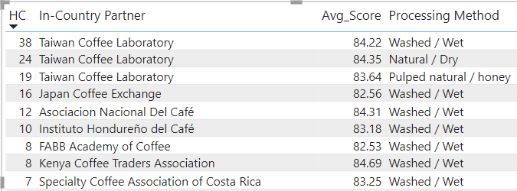
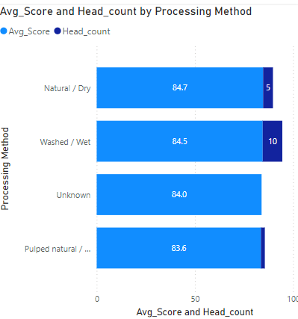
With 83 Observation Taiwan Coffee laboratory has highest QC . Washed /Wet has Highest Quality Score followed by Natural / Dry Processing method with less Defects
OBSERVATION

Slide 8
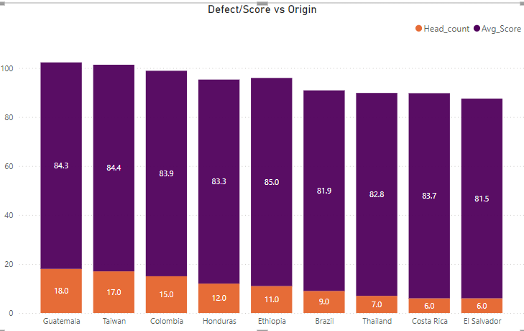
The country of origin "Taiwan" has the highest processing method and quality score, followed by "Guatemala". Though it has high defect , Quality Score has not impacted
Insights

Slide 9
Thank You

